Slide 1
BANKING ANALYTICS DASHBOARD
Team members
Group 5
Keshav Tiwari
Zainab Shaikh
Shruti Shekhar
Shreya
Manasi Patil
Sujan

Slide 2
Introduction
Banking analytics, also known as financial data analytics, uses data to help banks make better decisions. It involves collecting, processing, and analyzing data to gain insights into customer behavior, market trends, and risk assessments, ultimately helping banks improve their operations, reduce costs, and enhance the customer experience

Slide 3
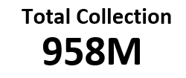





Slide 4
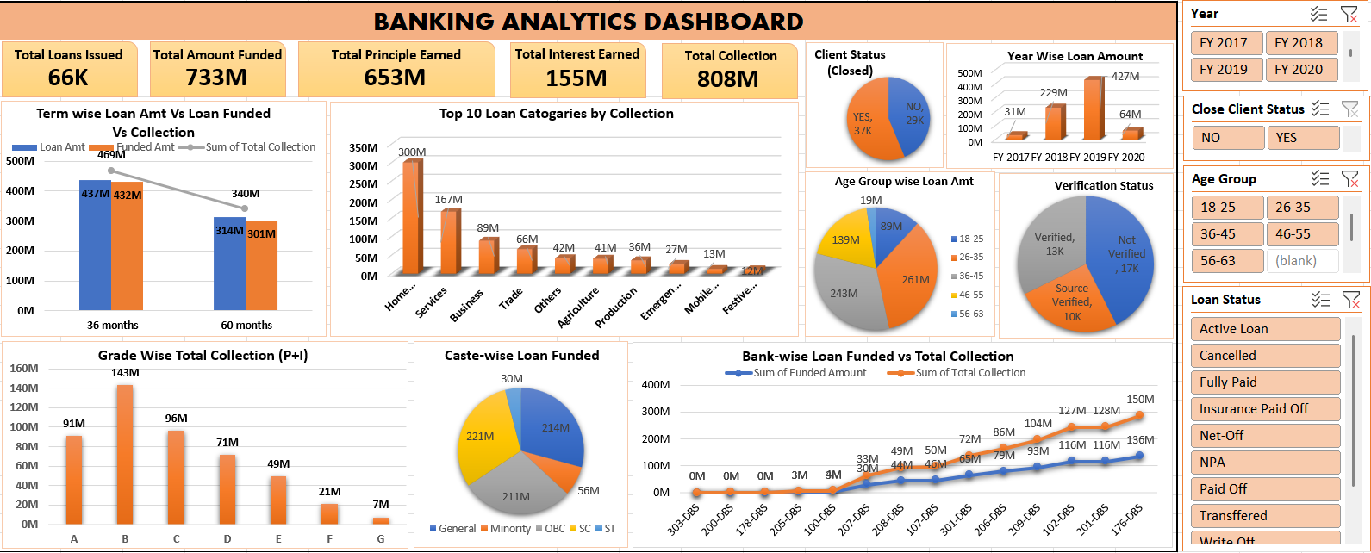
Excel Dashboard

Slide 5
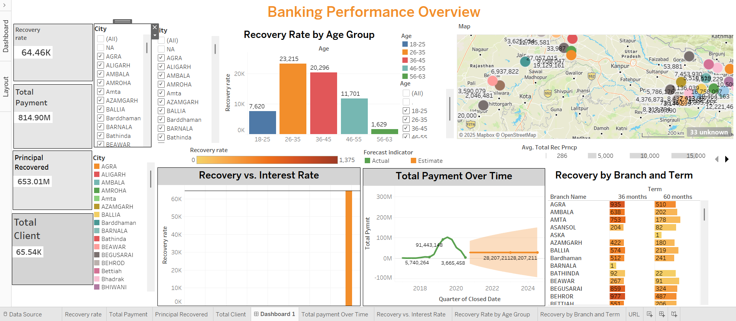
Tableau Dashboard

Slide 6
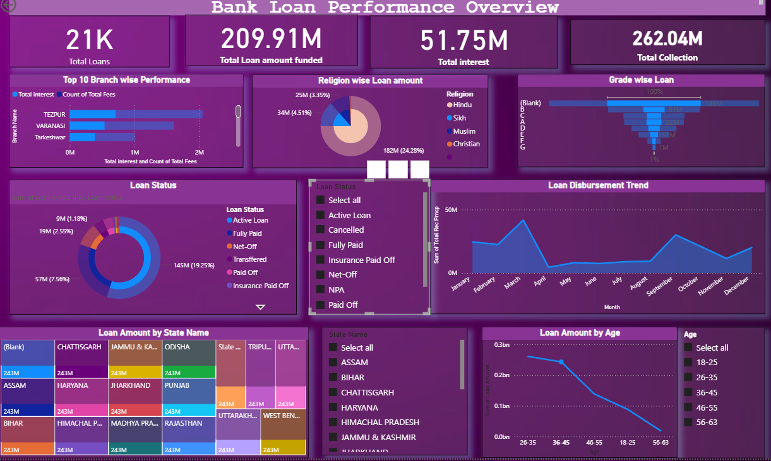
Power BI Dashboard

Slide 7
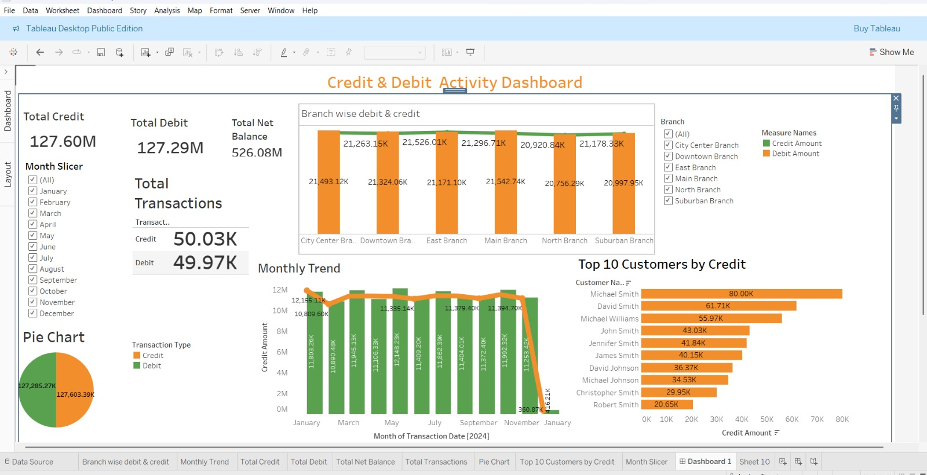

Slide 8
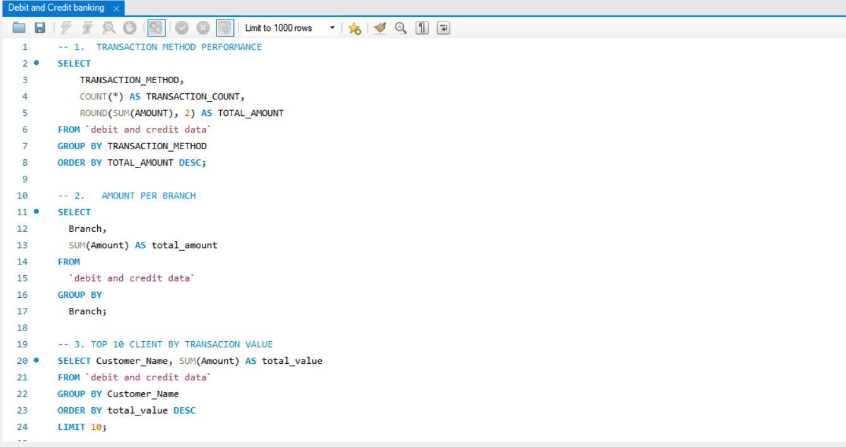
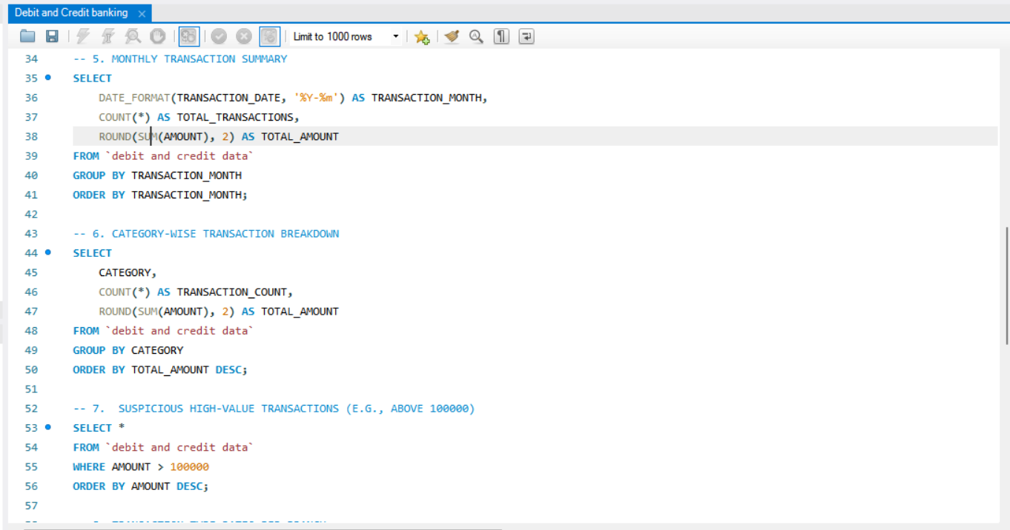

Slide 9
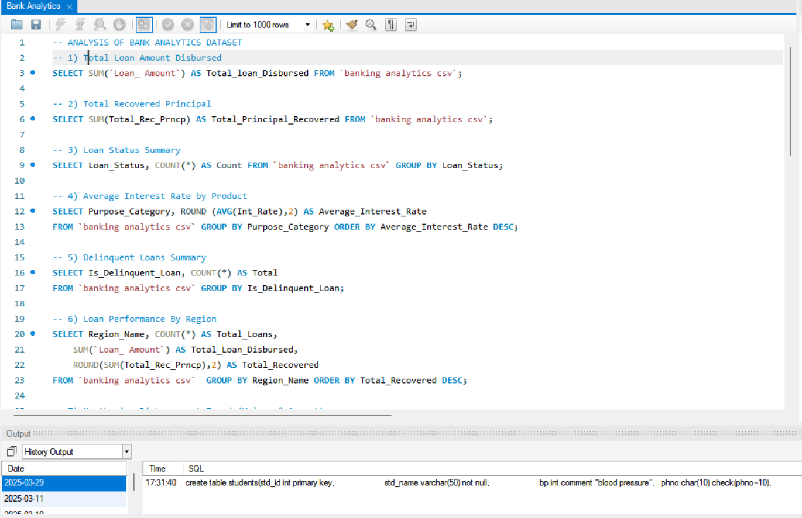
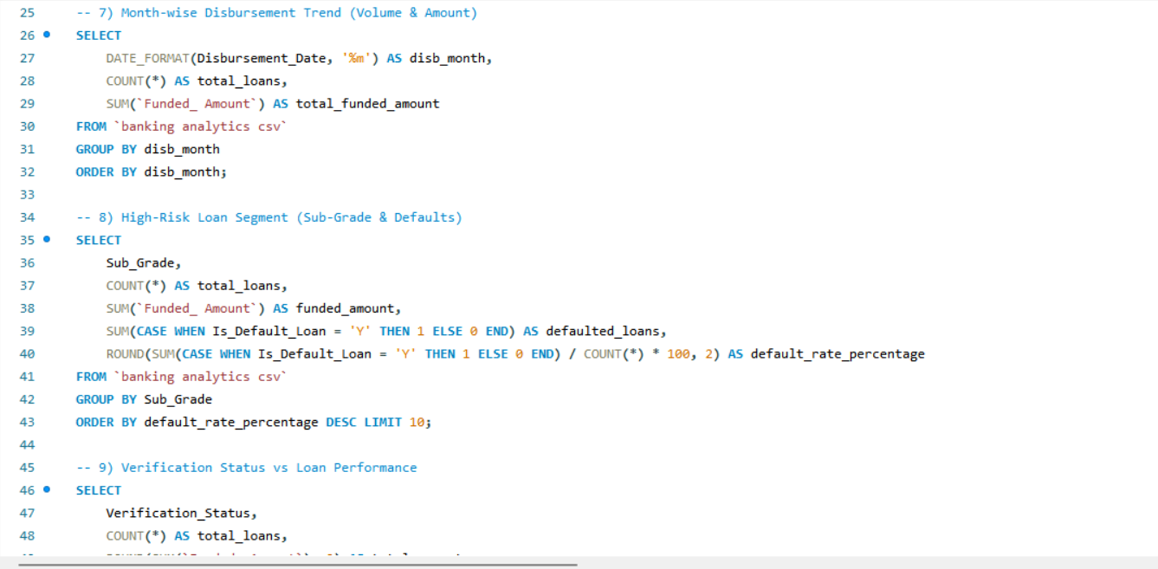

Slide 10
Project Summary
Banking analytics projects involve using data analysis techniques to understand and improve various aspects of financial institutions, such as customer behavior, risk management, and fraud detection
These projects aim to provide actionable insights that can help banks make informed decisions, optimize operations, and improve customer experience.

Slide 11
Key learnings from the project
This project strengthened my knowledge and hands-on skills in data preparation, KPI development, and dashboard creation using Tableau Public. It also improved my ability to analyze business performance and generate meaningful insights for decision-making, which are essential skills for a career in Data Analytics.

